Slide 1
EMPLOYEE DATA ANALYSIS USING EXCEL
STUDENT NAME : VISHAL R
DEPARTMENT : BACHELOR OFCOMMERCE REGISTER NO : 312213056 COLLEGE : VEL TECH RANGA SANKU ARTS COLLEGE

Slide 2


Slide 3
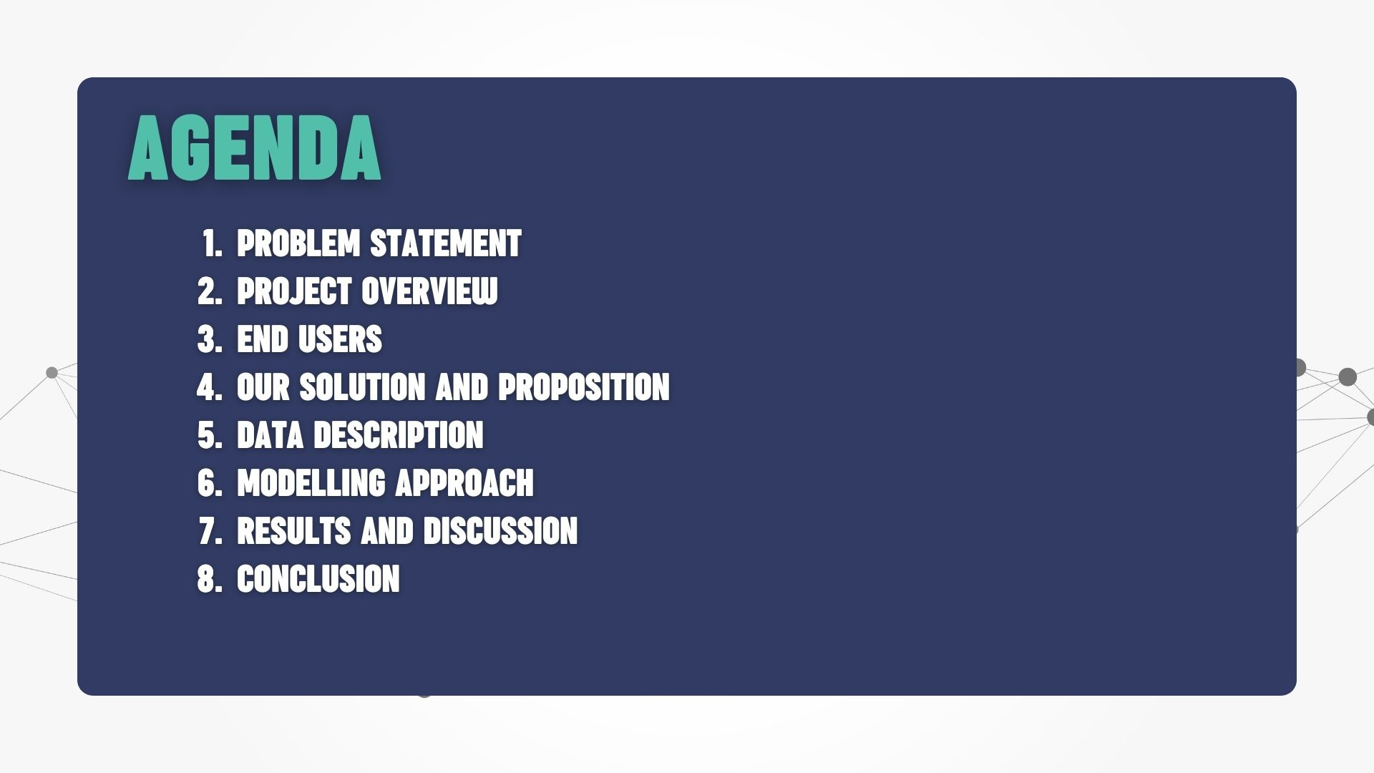

Slide 4
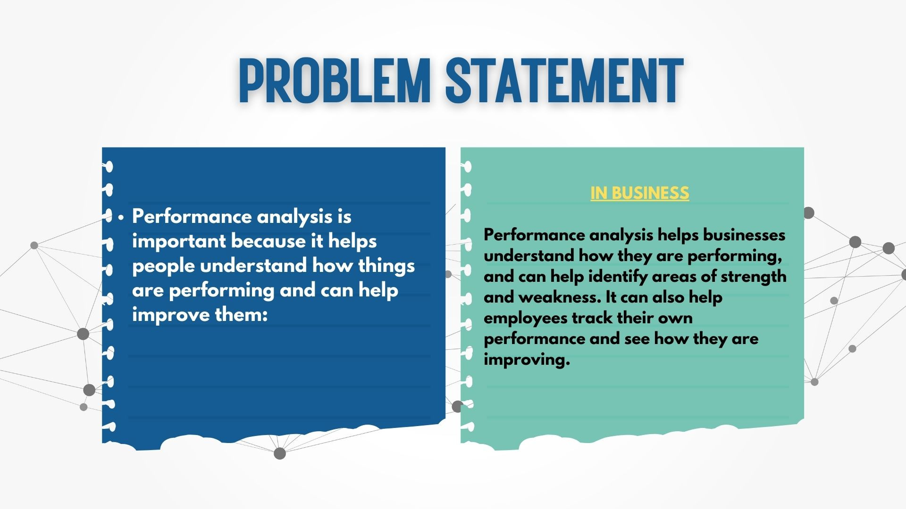

Slide 5


Slide 6


Slide 7
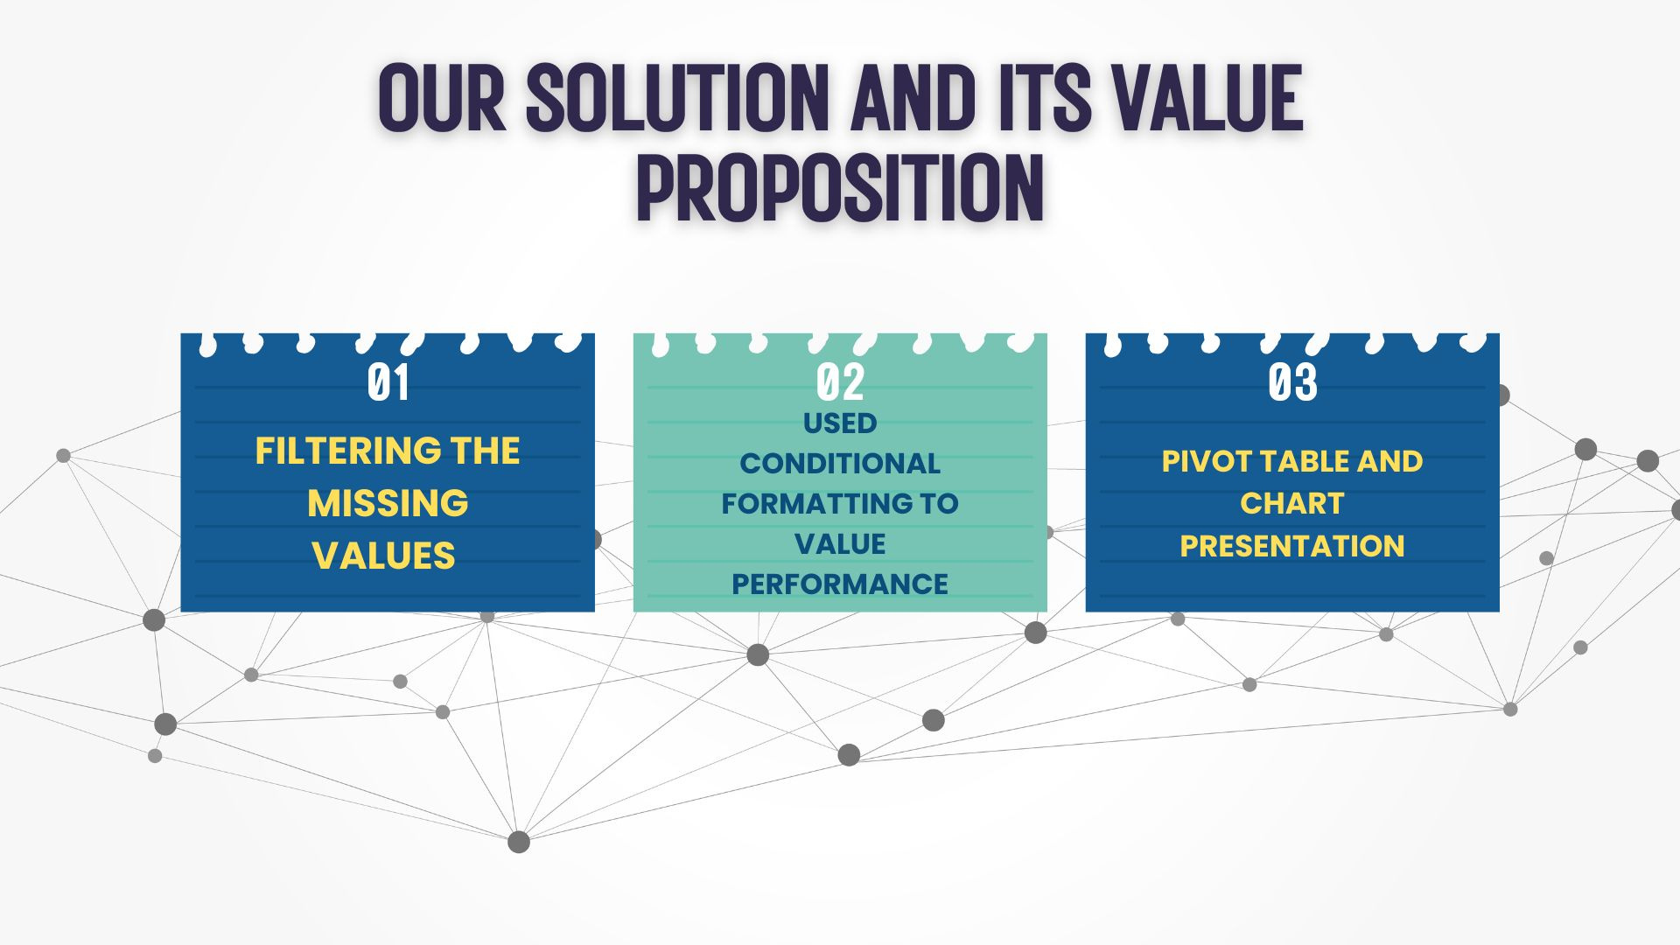

Slide 8
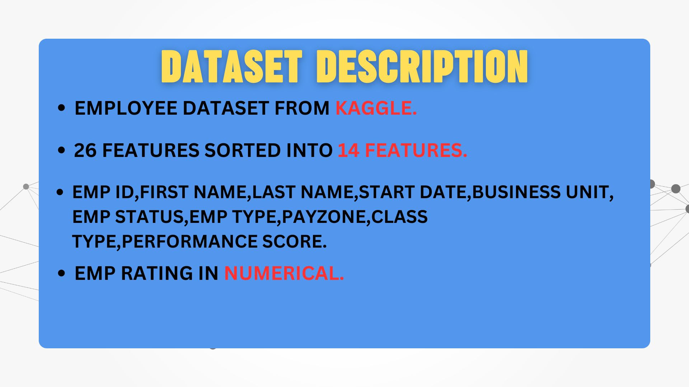

Slide 9
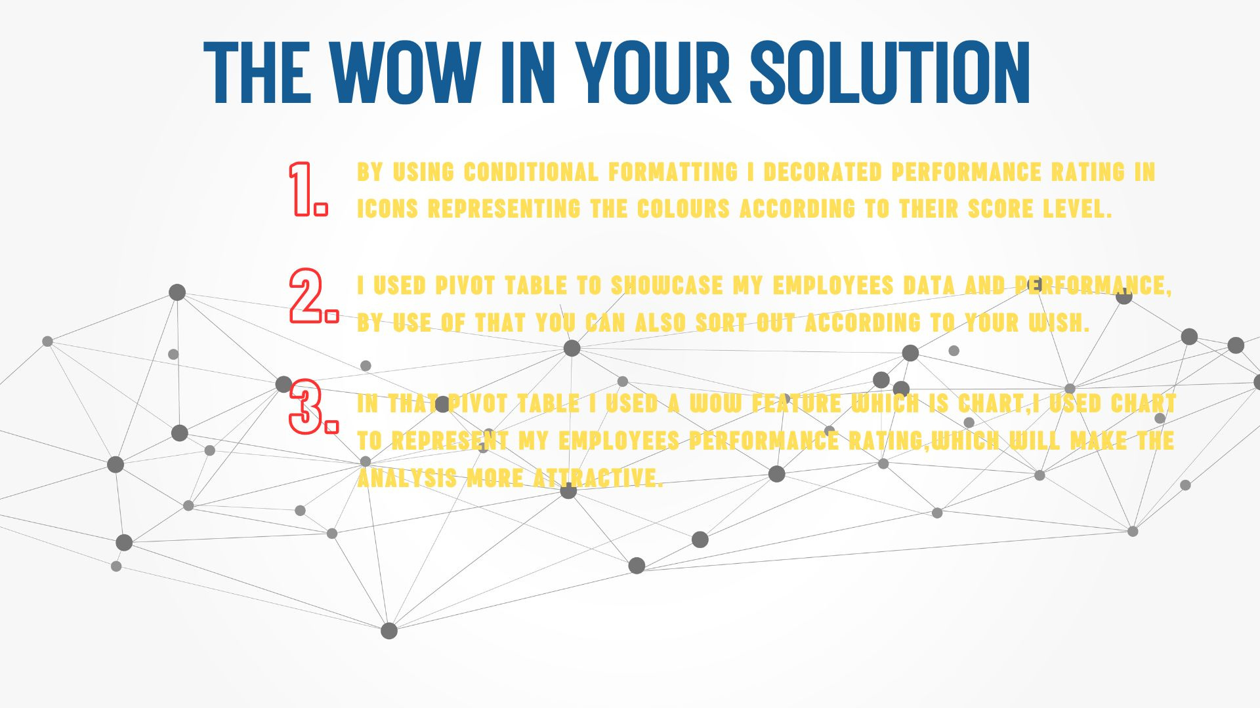

Slide 10


Slide 11
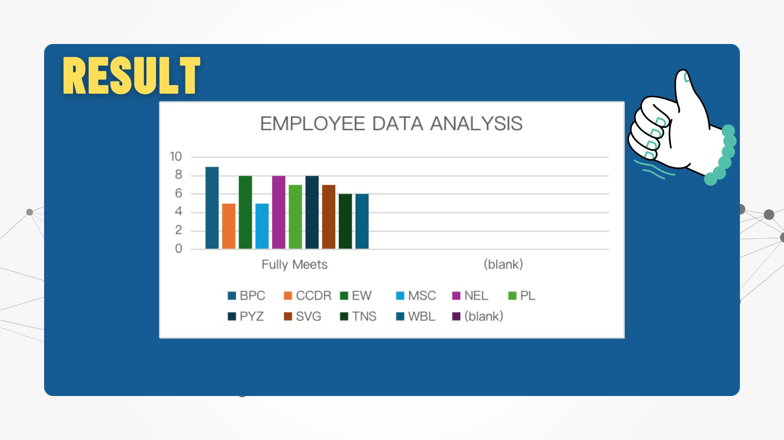

Slide 12


